Slide 1
University Life Manager
By- team shadow garden

Slide 2
Problem Statement
"Make A FullStack Website for Any Daily life problem that are faced by students within university." This application aims to provide a simple yet effective solution to the time and money management challenges that students often encounter.

Slide 3
About University Life Manager
University Life Manager is an aesthetic full-stack web application designed to help students manage their time and money efficiently. It addresses the common daily life problems faced by students within a university, allowing them to stay organized and on top of their expenses and schedule.

Slide 4
Features
Money Management: Track and manage your weekly expenses with an intuitive and easy-to-use interface.
Time Management: Organize your schedule and keep track of your commitments and deadlines.
Leaderboard: Compare your time and money management skills with fellow students.
Profile Management: Customize your profile and keep track of your progress.

Slide 5
Technologies Used
Frontend: HTML, CSS, JavaScript
Backend: Node.js, Express.js
Database: MongoDB
Styling: Custom CSS for a clean and aesthetic user interface

Slide 6
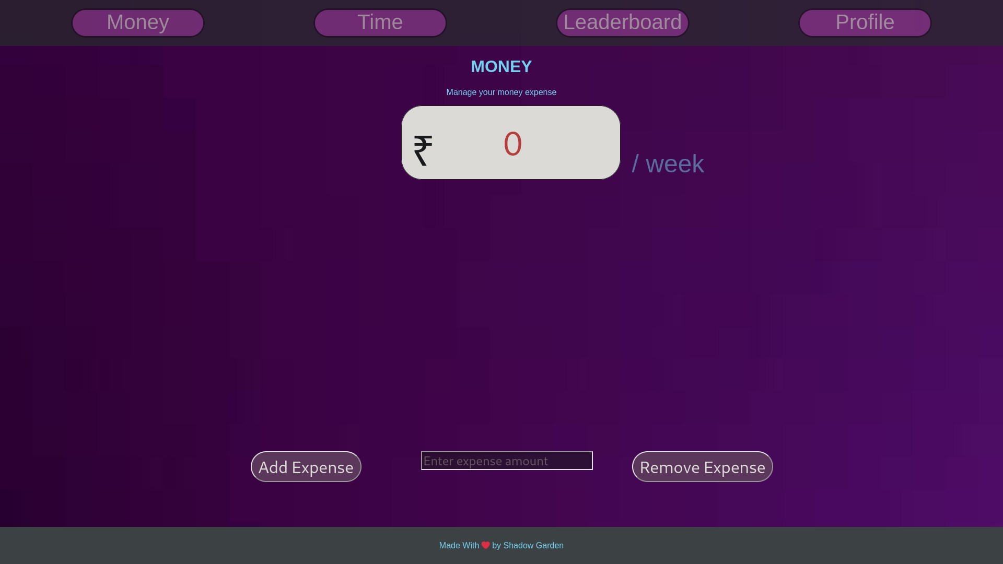

Screenshot

Slide 7
Team members- Ayush Mann - 23BSA10076 Anuranjan Jain - 23BAI10334 Lavisha - 23BEY10016

Slide 8
Thank You!

